Slide 1
Chapter 5. The Natural and Step Response of RL and RC Circuits(3)

Slide 2
Contents
Step Response of RC Circuits
Step Response of RL Circuits
General Solution Method for Natural and Step Response
Sequential Switching

Slide 3
Goals
  Understanding and ability to find the step response of first-order RC and RL circuits;
  Understanding and ability to analyze RC and RL circuits by general solution method;
  Ability to find response for sequential switching circuits.

Slide 4
Contents
Step Response of RC Circuits
Step Response of RL Circuits
General Solution Method for Natural and Step Response
Sequential Switching

Slide 5
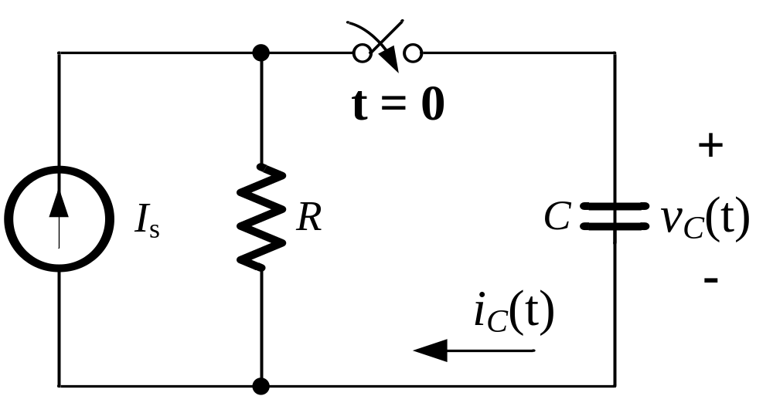
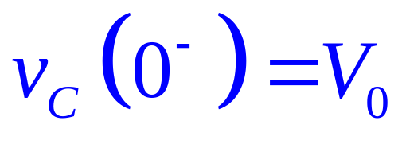
Step Response of RC Circuits
The capacitor has an initial voltage V₀;
The switch is closed at t = 0;
Energy is being stored in the capacitor.

Slide 6
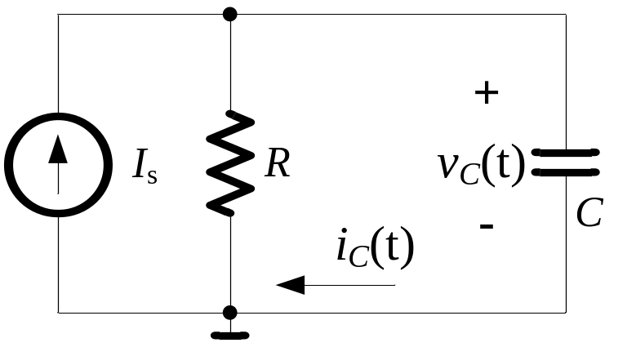
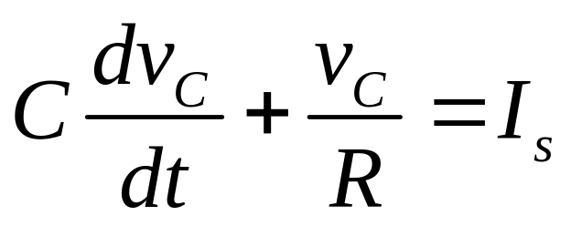
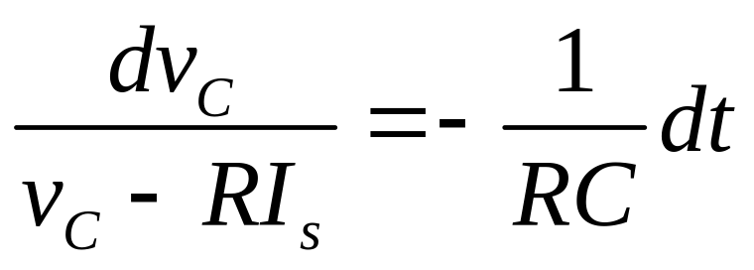

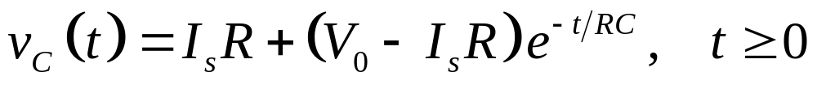
Step Response of RC Circuits
A
By KCL at node A:

Slide 7
Contents
Step Response of RC Circuits
Step Response of RL Circuits
General Solution Method for Natural and Step Response
Sequential Switching

Slide 8
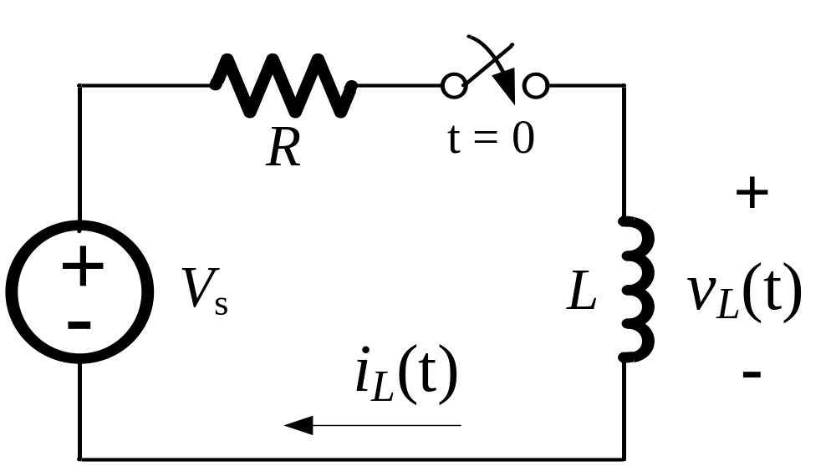
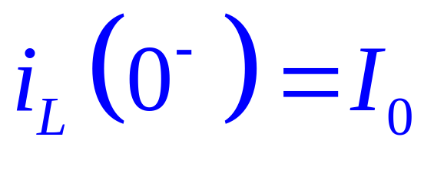
Step Response of RL Circuits
The switch is closed at t = 0;
The inductor has a initial current I₀;
Energy is being stored in the inductor.

Slide 9
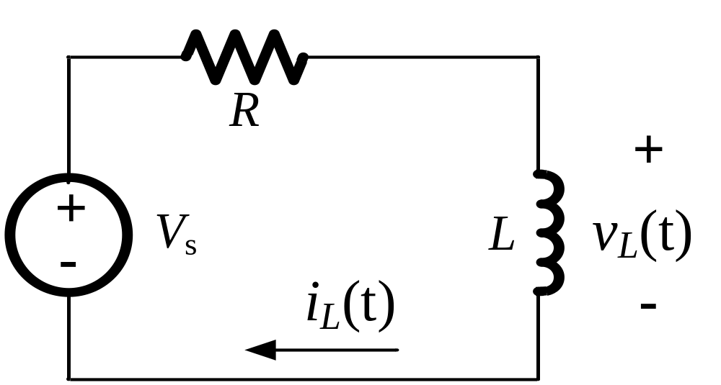

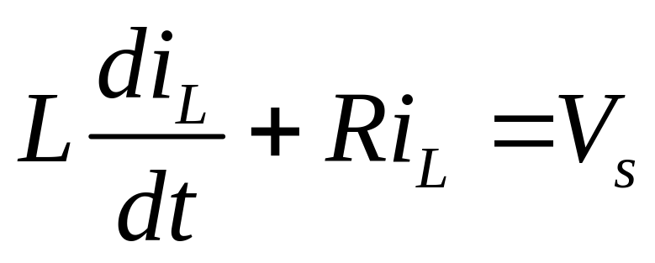
Step Response of RL Circuits
By KVL for the loop:

Slide 10
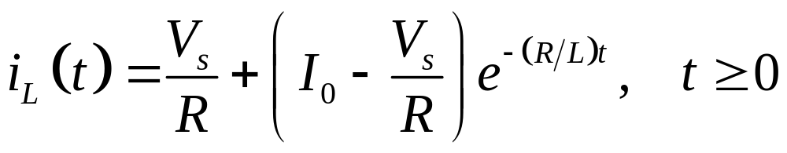
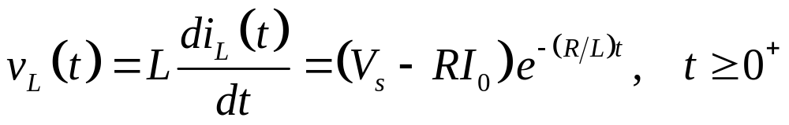
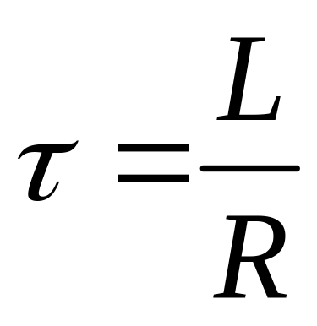
Step Response of RL Circuits
Time Constant:

Slide 11
Contents
Step Response of RC Circuits
Step Response of RL Circuits
General Solution Method for Natural and Step Response
Sequential Switching

Slide 12
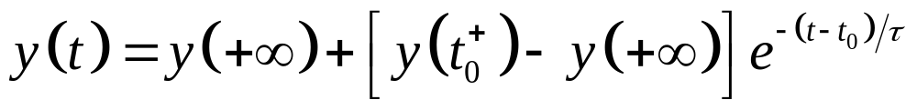
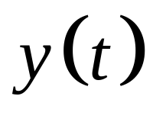
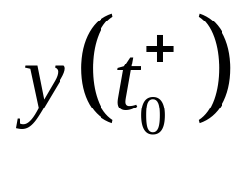
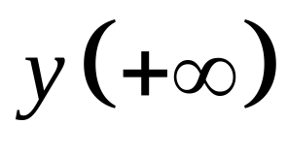
General Solution
:Response of voltage or current
: Initial value of voltage or current
: Final value of voltage or current

Slide 13
Summaries
  Understanding and ability to find the step response of first-order RC and RL circuits;
  Understanding and ability to analyze RC and RL circuits by general solution method;
  Ability to find response for sequential switching circuits.

